Slide 1


November 2025

Slide 2



Vestavia Hills, AL
Galactic is a PEO that has delivered comprehensive employer services to Kitchen Guard locations all over the United States.
Our Core Values:
• Precision & Excellence • Service with a purpose
• Desire to learn & Grow • Team-oriented
• Trustworthiness

Slide 3

Galactic is a PEO (Professional Employer Organization).
Galactic partners with you to manage HR functions like payroll, benefits, compliance, and more. We act as your administrative employer, while you remain as the job site employer. Galactic works to improve your business by streamlining HR operations, reducing administrative burdens, ensuring compliance, and giving you access to better employee benefits so you can focus on growing your business.
Focus on Your Business
You’re the Boss
By outsourcing payroll and administrative tasks to Galactic, you add productive hours to your business.
You’re the job site employer. You’ll still be responsible for hiring, firing, and supervising your employees.

Slide 4


Easily import data from time and attendance platforms
automated payroll advance incorporation
Specialized payroll reports and data files
Seamlessly integrated benefits deductions for your employees
Galactic handles all local, state, and federal tax reporting
Direct Deposit of employee net pay
Maintenance of payroll deductions
Employees can easily access pay stubs and W-2s in their personal employee portal

Slide 5



Compliance with state & federal agencies on Form W-4, I-9, E-Verify and state withholding forms
WOTC Tax Credits for applicable new hires
EPLI Coverage limits $1,000,000 / $2,000,000 ($25k deductible)
Time and Attendance via webclock, phone app with geo-fencing, timeclock hardware with dashboard, reporting, exceptions, and integration with payroll.
Assistance in HR areas (FLSA, ADA, FMLA, Terminations, Discrimination, Sexual Harassment)
HIPPA & Cobra administration
Assistance with design and publishing of Employee Handbooks

Slide 6


{#benefits.health_insurance}GalactiCare Health Care{/benefits.health_insurance}
Eligibility Notification
Health Plans available providing nationwide coverage.
Galactic provides notification when employees become eligible for benefits, need to complete enrollment, etc.
{#benefits.four01k}401(k) Retirement Plan{/benefits.four01k}
Competitive Rates
Galactic partners with to provide 401(k) solutions. Custom eligibility and company match options available.
Galactic offers competitive rates on company paid Life and Disability Insurance
{#benefits.section125}Section 125 Cafeteria Plan{/benefits.section125}
Here for You
Pre-tax dependent care and out of pocket medical like copays, deductibles, etc.
Galactic manages premium payments and reconciliation and assists with claims.
{#benefits.supplemental}Voluntary Group Plans{/benefits.supplemental}
Voluntary dental, life, STD/LTD, and other ancillary benefits are available.

Slide 7

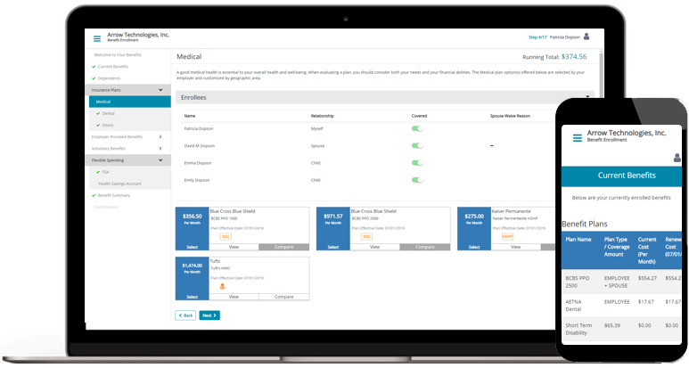
Services & Features
Easy Enrollment on Any Device
Managing benefit elections is simple no matter what device an employee uses (desktop, laptop, or mobile).
Crystal Clear Plan Comparison
An intuitive user experience and online tools help employees make selections that fit their needs.
Faster, More Accurate Enrollment
Alerts let employees know when required information is missing, taking the manual effort out of following up to ensure selections are completed.
Happier, Healthier Employees
Employees who are better informed about their plan options can more confidently enroll in the right plans and take advantage of benefits.

Slide 8

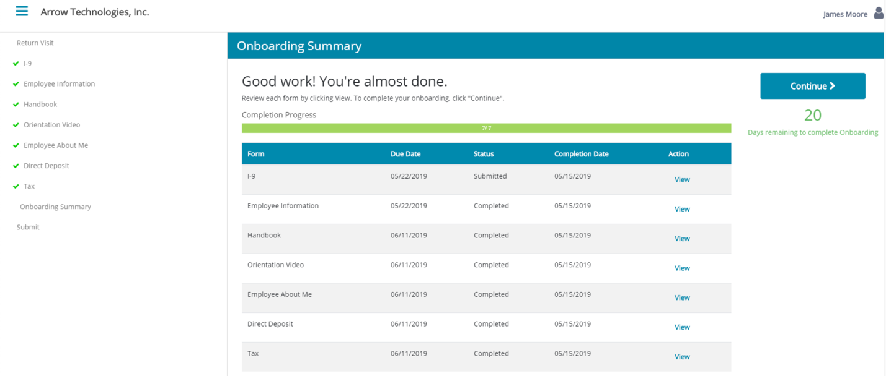
Paperless Onboarding
New employees can quickly complete required employment forms, view faculty and organization charts, watch videos, and more.
Custom Workflows
Create custom onboarding plans for both new hires and internal movement of employees from one position to another.
Employee Self-Service
The Employee Portal allows new employees to access forms, videos, calendars, policies, and benefit information at any time.
Securely Track Documents
All forms and documents are securely tracked and stored electronically. Digital signatures can be easily captured for complete and auditable records.

Slide 9

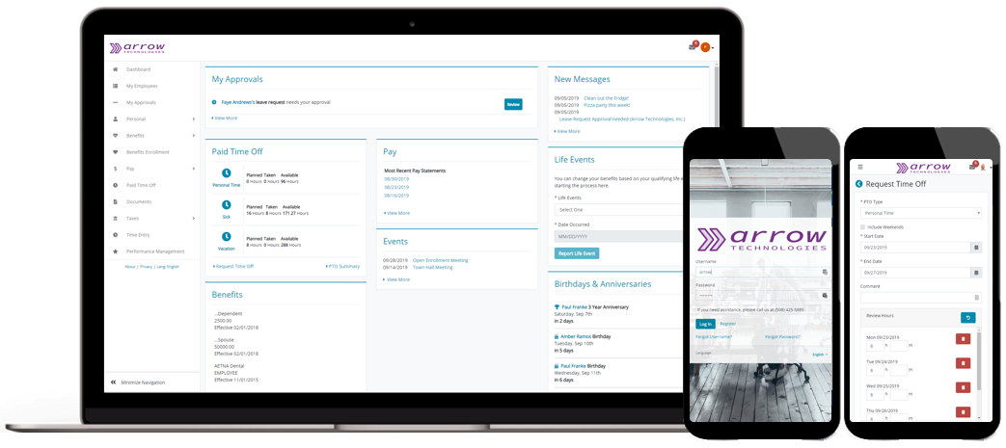
Employee Information & Tools
Benefits details and enrollment
Pay stubs
Paid Time Off requests (and approvals for managers)
Document management (e.g., policies, handbooks)
Personal contact and employment information
Company event and holiday calendar
Tax documents (e.g., W-2)
HR support contacts
Company-wide announcements
 | 24/7 Access from Any Device With its responsive design, Employee Portal looks and works great on a smartphone, tablet, laptop or desktop. |  | Simplify Manager Approvals At work or on the go, managers can easily review and approve time off requests—even on mobile devices.
 | Keep Employee Data Safe Multi-factor authentication verifies a user’s identity and provides additional security against unauthorized access. |  | Reduce Support Requests Employees can quickly retrieve their username or reset their password without assistance from support staff.

Slide 10


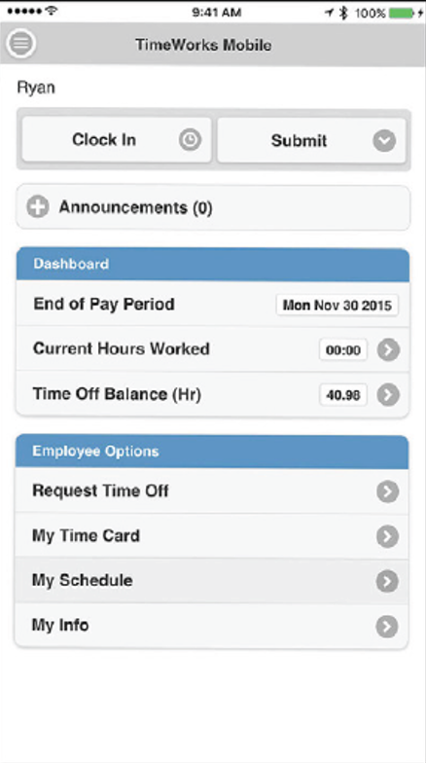
Fewer Errors
Intelligent clock technology helps eliminate duplicate or missed punches and errors computing total hours and pay.
Clock Lockout
Limit early clock in, scheduling warns when overtime approaches, managers easily view timecards in real time.
Eliminate Unplanned Overtime
Restrict unplanned overtime with rules and alerts. Compare budgeted hours to actual worked time in real time.
Flexible Configuration
Customized pay rules, overtime calculations, compliance requirements and accrual application. Wide range of physical and online clock options.
Mobile Access
Administrators and employees have convenient access to mobile punch clocks and administration tools from any mobile device.
Faster Payroll Processing
Fewer errors, instant access for timecard review and export to payroll reduces time spent processing payroll.
Timekeeping
Captures time data from clocks, calculate multiple rates, accruals, and keeps audit trail.
Geofencing
Makes it easy to see who showed up at the right place and when. Unlimited geofences allow you to track every location. Mobile clocks simplify compliance.
Filtered Clock Prompts
Filter clock prompts by employee or group to reduce punch choice, save time and reduce errors.
Overtime Management
Auto-apply overtime or proactively alert as thresholds approach. Flexible calculations and application.
Payroll Integration
Easy timecard review and approval. Connects time data to payroll processing for fewer errors and faster completion.

Slide 11

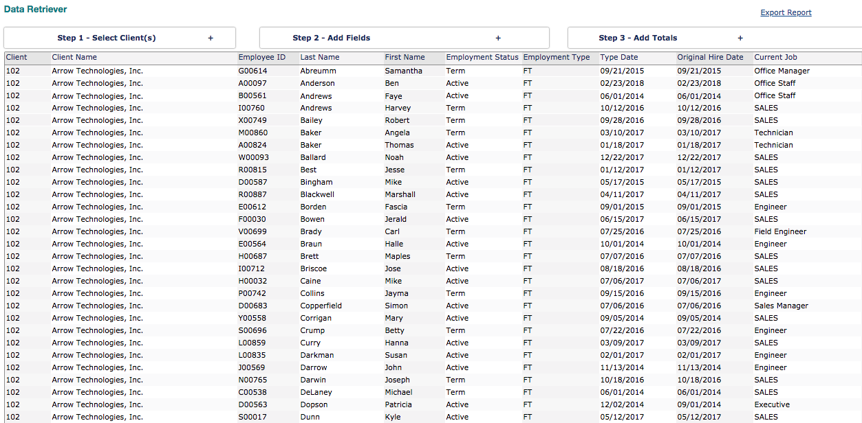
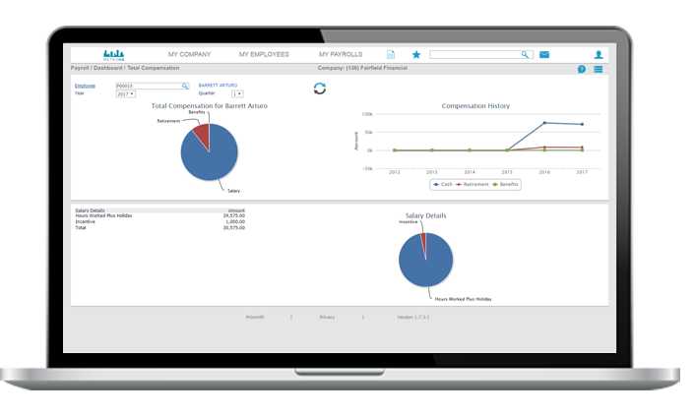
Simple, Yet Powerful Reporting
Using a simple and easy-to-use dashboard, you can search to quickly find any report you need and add frequently-used reports to the “favorites” menu for faster access. Pre-built reports let you quickly access payroll, HR and employee data that can be filtered using a wide range of parameters.
Advanced Reporting with Data Retriever
Go deeper and get the specific data you want with Data Retriever. Data Retriever makes it easy to select the data you want and quickly view or export to Excel. Additionally, if there is information that you need to access on an ongoing basis, you can create and save templates within Data Retriever.

Slide 12


Partnered with:
By joining the Galactic Employer Services 401(k) Plan, you can provide an outstanding retirement plan, help save money and spend less time administering it.
Let us Handle the Paperwork For You
Member Benefits
No annual audit
Cost savings on the investments
No individual Form 5500 reporting
Minimal plan maintenance
Flexible plan features, including safe harbor, Roth, and profit sharing
Customizable 401(k) plan design options involving eligibility, matches, vesting schedules, and more
By participating in the Galactic Employer Services 401(k) Plan, virtually all administrative tasks can be offloaded from you to and Galactic Employer Services.
Tasks that can be shifted may include:
Administrative responsibilities
Employee eligibility tracking
Distribution processing
Plan compliance
Nondiscrimination testing
Annual reporting
Participant enrollment/education

Slide 13

Number of Employees: {{employees_count}}
Pay Frequency: Bi-Weekly / Monthly / Quarterly
Initial Setup Fee: {{fees.initial_setup}}
ACA Conversion/Setup: {{fees.aca_setup}}
Time & Attendance: {{fees.time_attendance}}
Workers’ Comp Deposit: {{fees.workers_comp_deposit}}
Galactic Admin Fee: 0.80% of Gross Payroll
Employer Taxes including but not limited to: **Subject to annual wage limits
FICA, Social Security and Medicare ................................................. {{fees.fica_pct}}%
FUTA Federal Unemployment Tax ................................................... {{fees.futa_pct}}%
SUTA AL State Unemployment Tax .................................................. {{fees.suta_al_pct}}%
SUTA GA State Unemployment Tax ................................................. {{fees.suta_ga_pct}}% SUTA FL State Unemployment Tax ................................................... {{fees.suta_fl_pct}}%
Workers Compensation Insurance
Clerical Office Employee AL.8810 .................................................. {{fees.wc_8810_pct}}%
Outside Sales FL.8742 ................................................................ {{fees.wc_8742_pct}}% HVAC FL.8010 .......................................................................... {{fees.wc_8010_pct}}% HVAC AL.8010 .......................................................................... {{fees.wc_8010_pct}}%

